Slide 1

CS 533 INTRO TO DATA SCIENCE
Michael Ekstrand

Slide 2
MODELING

Slide 3

Learning Outcomes
Understand the relationship of models to reality
Photo by Andrew Neel on Unsplash

Slide 4
What Is a Model?
A mathematical representation
Of the essential dynamics
Of a system of interest

Slide 5
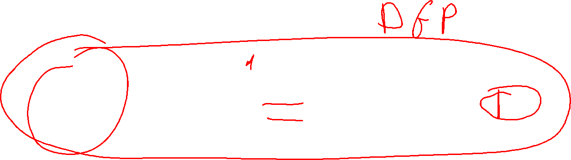
Data Pipeline
Things
Phenomena / Experiment
“Raw” Data
Answers
Inferences
Data Set

Slide 6
Data Generating Process
Things
Phenomena / Experiment
“Raw” Data

Slide 7

Statistical Modeling
Simplify the DGP to predict an outcome
Correlational models look at relationships between observables
No causal claim unless experiment design enables it
Causal models model DGP more deeply to estimate causality
Subtle and quick to anger

Slide 8
Simplifications
Models necessarily simplify the problem
They hopefully capture enough to infer or predict usefully.
Unpredicted value is residual or error.

Slide 9
Movie Genres
Genre(s)
Movie
?
Reviews

Slide 10
Parameters
Model parameters are numeric values as part of the model.
We estimate them from the data.
Mean critic rating for each genre (how to handle multiple membership?)
If the model captures the DGP, these are also underlying population parameters.

Slide 11
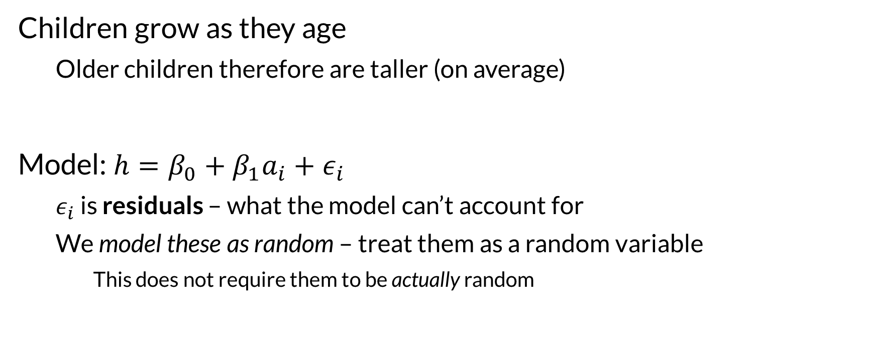

Example (adapted from Wikipedia)
Children grow as they age
Older children therefore are taller (on average)
Model: $h=β_{0}+β_{1}a_{i}+ε_{i}$
$ε_{i}$ is residuals – what the model can’t account for
We model these as random – treat them as a random variable
This does not require them to be actually random

Slide 12

Wrapping Up
Models simplify a process so we can understand or predict features of interest.
They are simplifications of the data generating process, to learn about it.
Photo by Scarbor Siu on Unsplash

